Slide 1
Payroll management system
By VANIPRIYA PR

Slide 2
Agenda
Abstract
Technologies
ER Diagram
Output Screenshot

Slide 3
Abstract
The Payroll & Leave Management System is designed to automate and simplify employee salary processing and leave tracking in an organization. The system ensures accurate payroll calculations, systematic employee record management, and transparent leave monitoring. It enables administrators to add employees, approve leave requests, set salary allowances, and generate monthly salary reports, while employees can apply for leave and track their leave status.Developed using Java and MySQL, the system follows a modular architecture with secure login validation and database-driven workflows. It eliminates manual paperwork, reduces processing time, prevents salary errors, and maintains a structured leave balance record for each employee. This solution enhances efficiency, accuracy, and transparency in HR operations, making it a reliable backend foundation for future web or enterprise-level payroll systems.
.

Slide 4
Technologies
Component | Technology
Frontend | CLI Console (Java)
Backend | Java (OOP + JDBC)
Database | MySQL
Architecture | Layered MVC + DAO
Tools | IntelliJ IDEA, MySQL Workbench
Language | Java SE 17

Slide 5
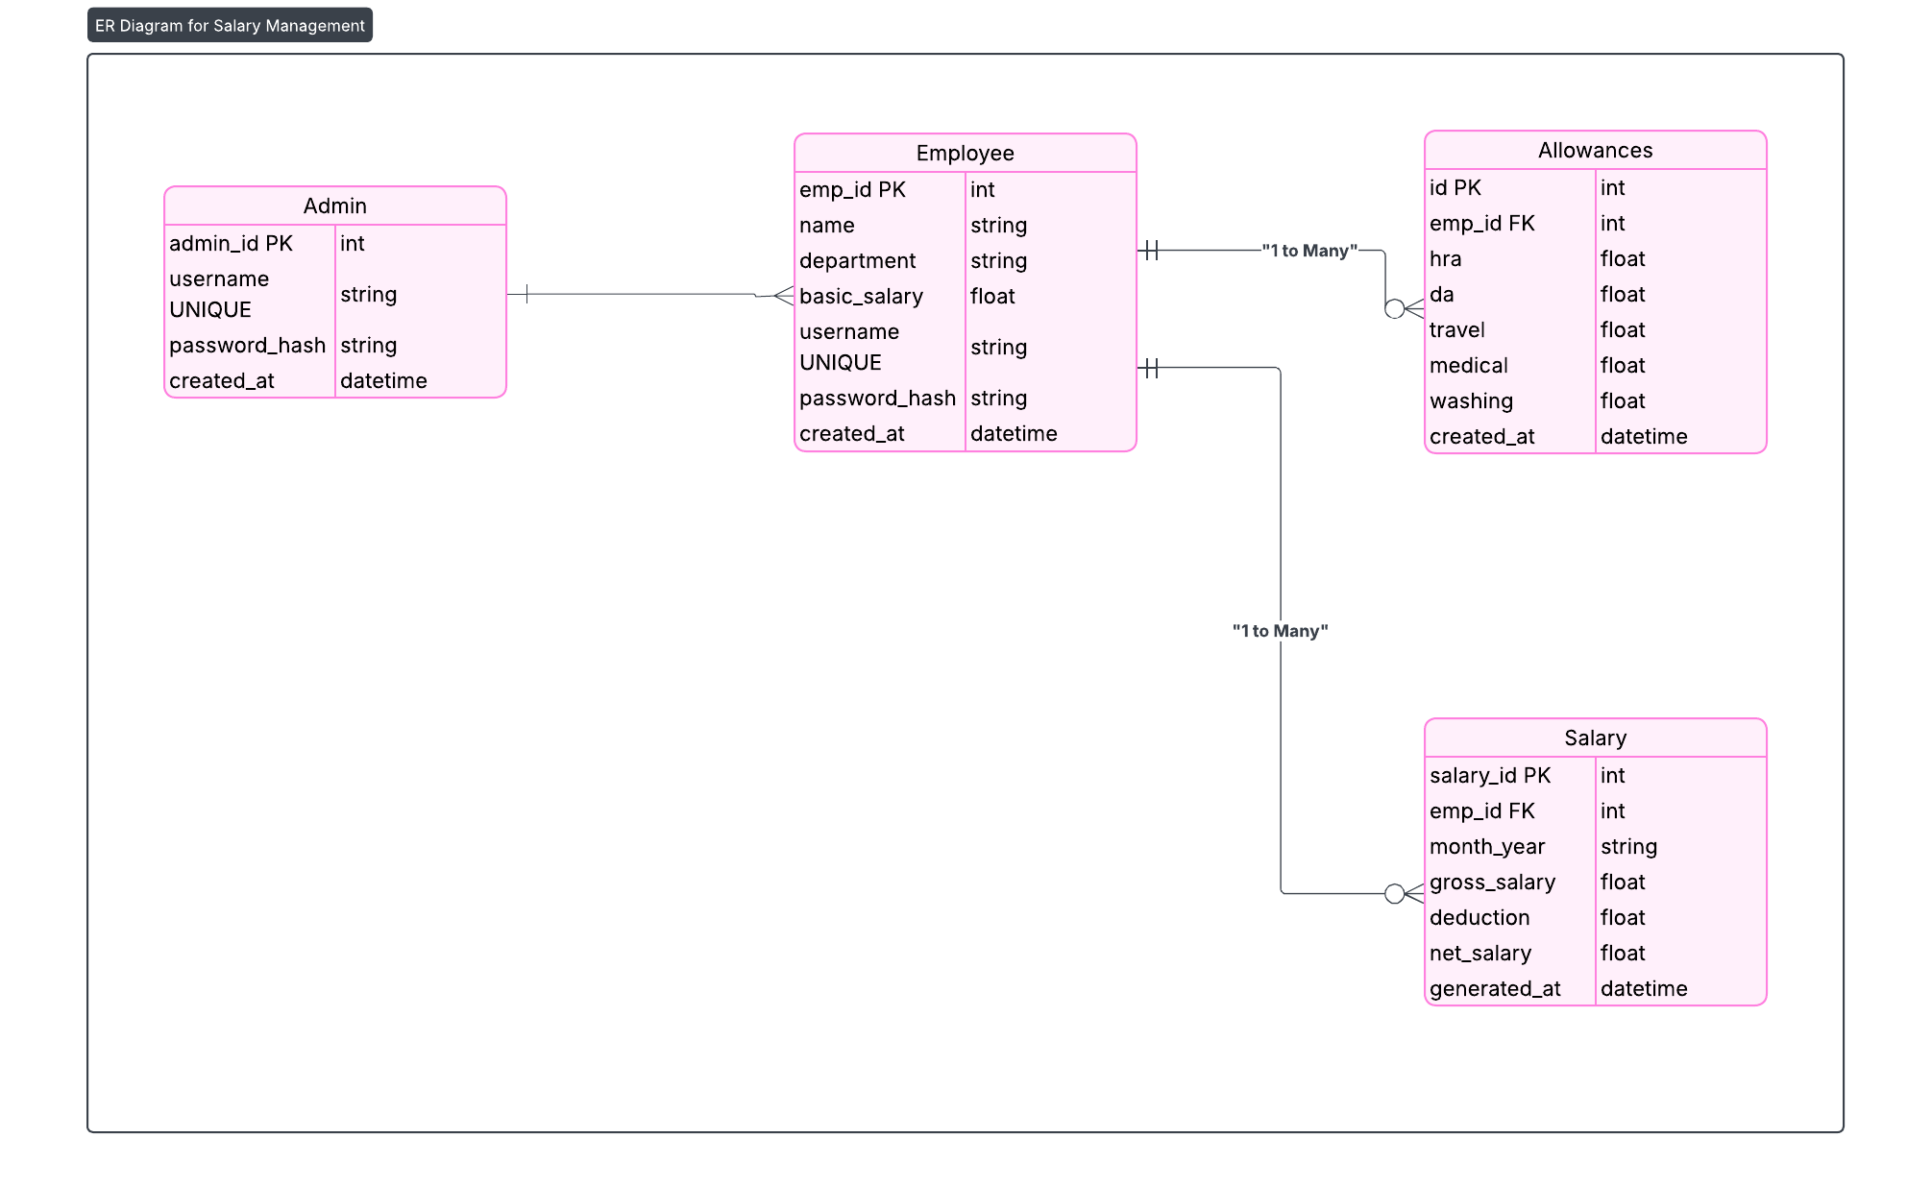
Er diagram

Slide 6
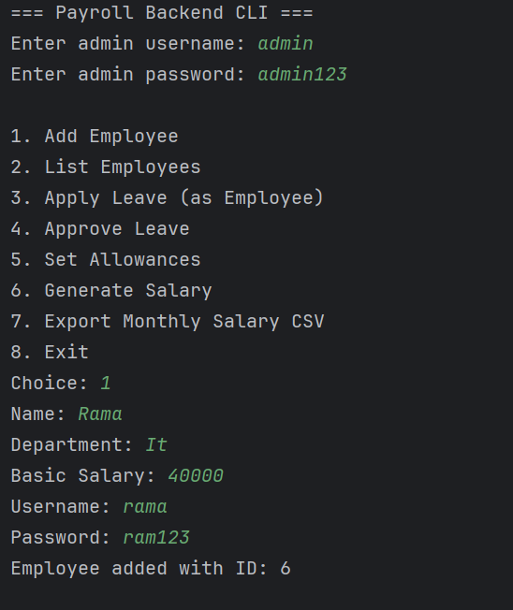
OUTPUT

Slide 7
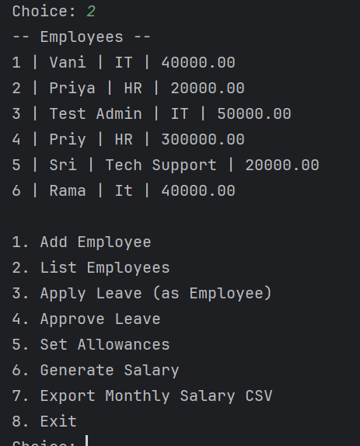

Slide 8
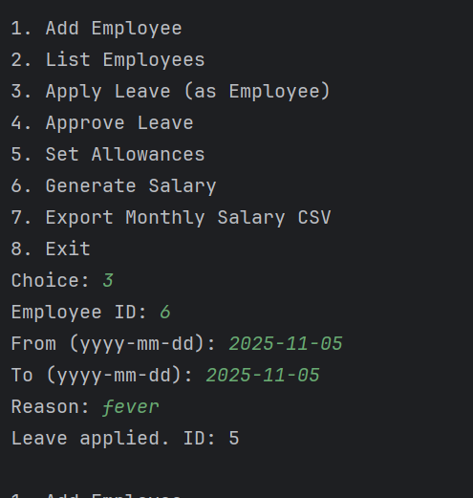

Slide 9
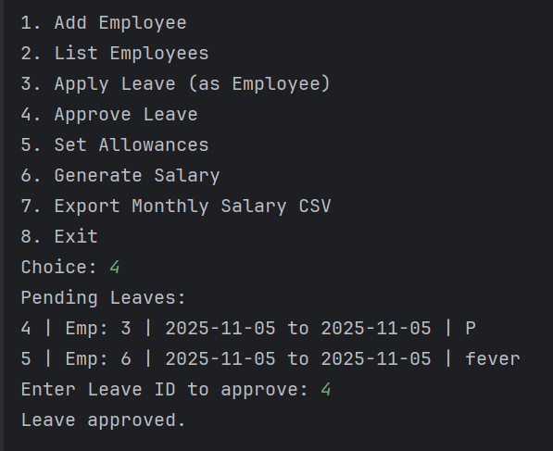

Slide 10
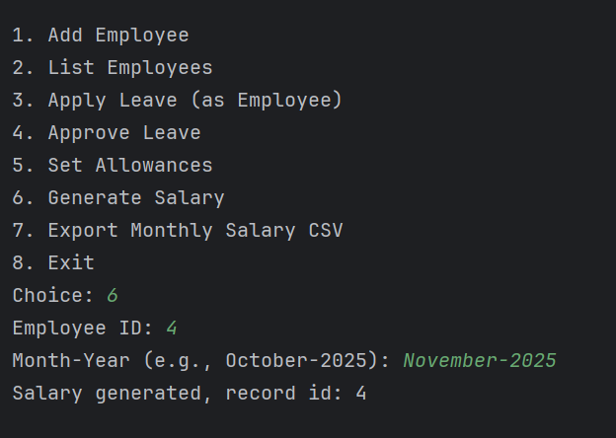

Slide 11
Thank you

